Slide 1
Predicting
Heart Disease
Shyla Sharma, Sherry Hancock, Jacob Brandis

Slide 2
Project Overview
Project Goals
About Our Data
Demographics - Coefficients and Model
Medical Factors - Coefficients and Model
External Factors - Coefficients and Model
Conclusion

Slide 3
Project Goals
Determine demographic factors with most impact on heart disease
Determine medical history (stroke, diabetes, etc.) that has the most impact on whether someone has heart disease
Determine external factors (sleep time, smoking, etc.) that have the most impact on whether someone has heart disease
Use these demographic, external, and medical factors to create a model to predict whether someone will have heart disease

Slide 4
About Our Data
Our data comes from the 2020 annual CDC survey related to health status.
319,795 rows / 18 columns
Parameters used:
Demographics: Age, Race, and Gender
Medical: Stroke, Asthma, Diabetes, Kidney Disease, and Skin Cancer
External: Smoking, Alcohol, BMI, Sleep, Physical Activity, General Health, and Difficulty Walking
Balanced dataset

Slide 5
Demographics
Age, Gender, and Race

Slide 6
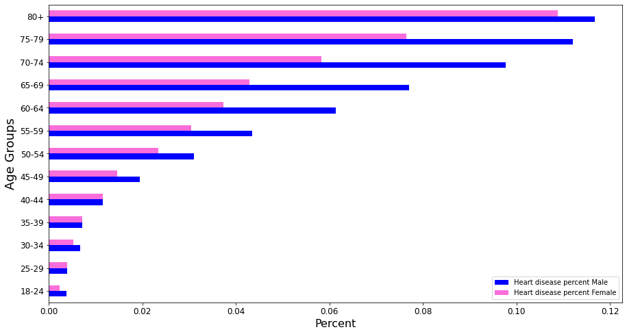
Percent of Heart Disease by Age Group and Sex

Slide 7
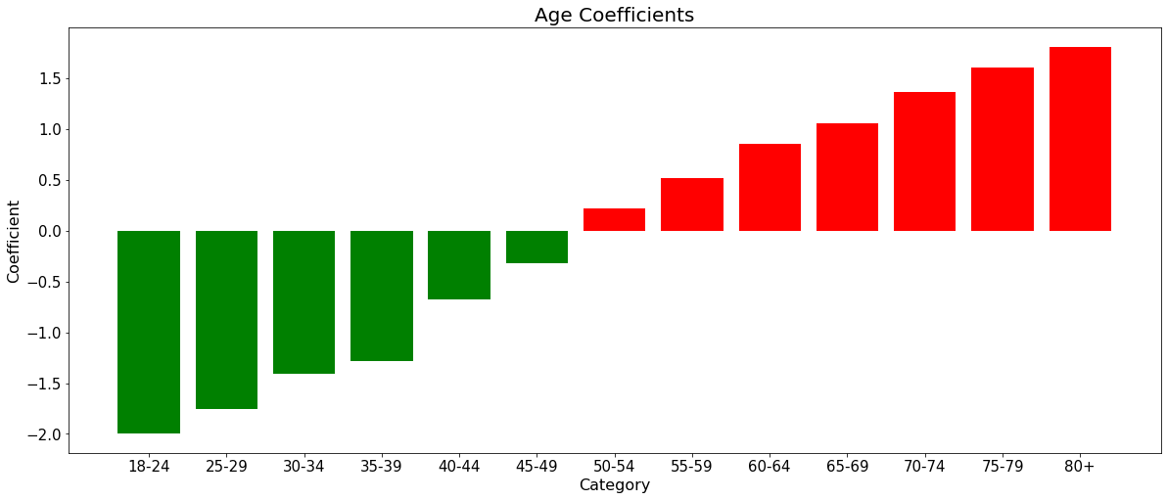
Demographic Coefficients - Age

Slide 8
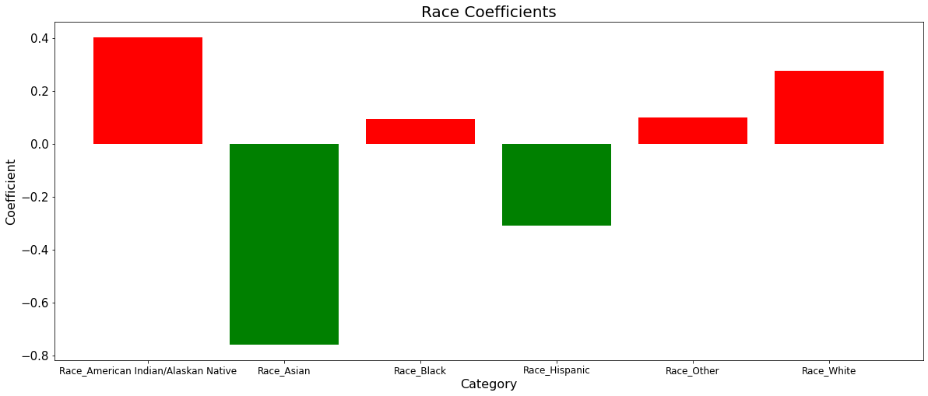
Demographic Coefficients - Race

Slide 9
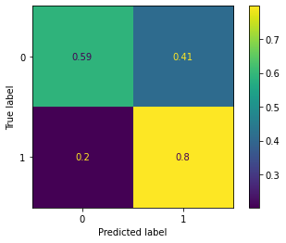
Logistic Regression (Age+Sex+Race)
Factors used:
All Ages, All Races, and Sex
Accuracy: 59.56%
AUROC Score: 0.69

Slide 10
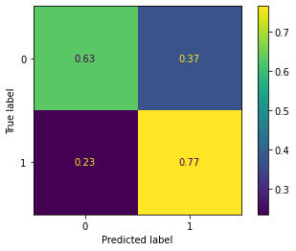
Ensembling (Age+Sex+Race)
Factors used:
All Ages, All Races, and Sex
Accuracy: 63.31%
AUROC Score: 0.69

Slide 11
Medical Factors
Stroke, Diabetes, Asthma, Skin Cancer, Kidney Disease

Slide 12
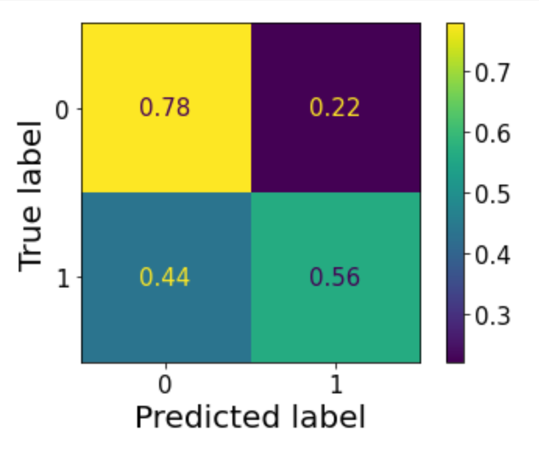
Logistic Regression (Just Medical Factors)
Factors used:
Kidney Disease, Skin Cancer, Diabetes, Asthma, and Stroke

Slide 13
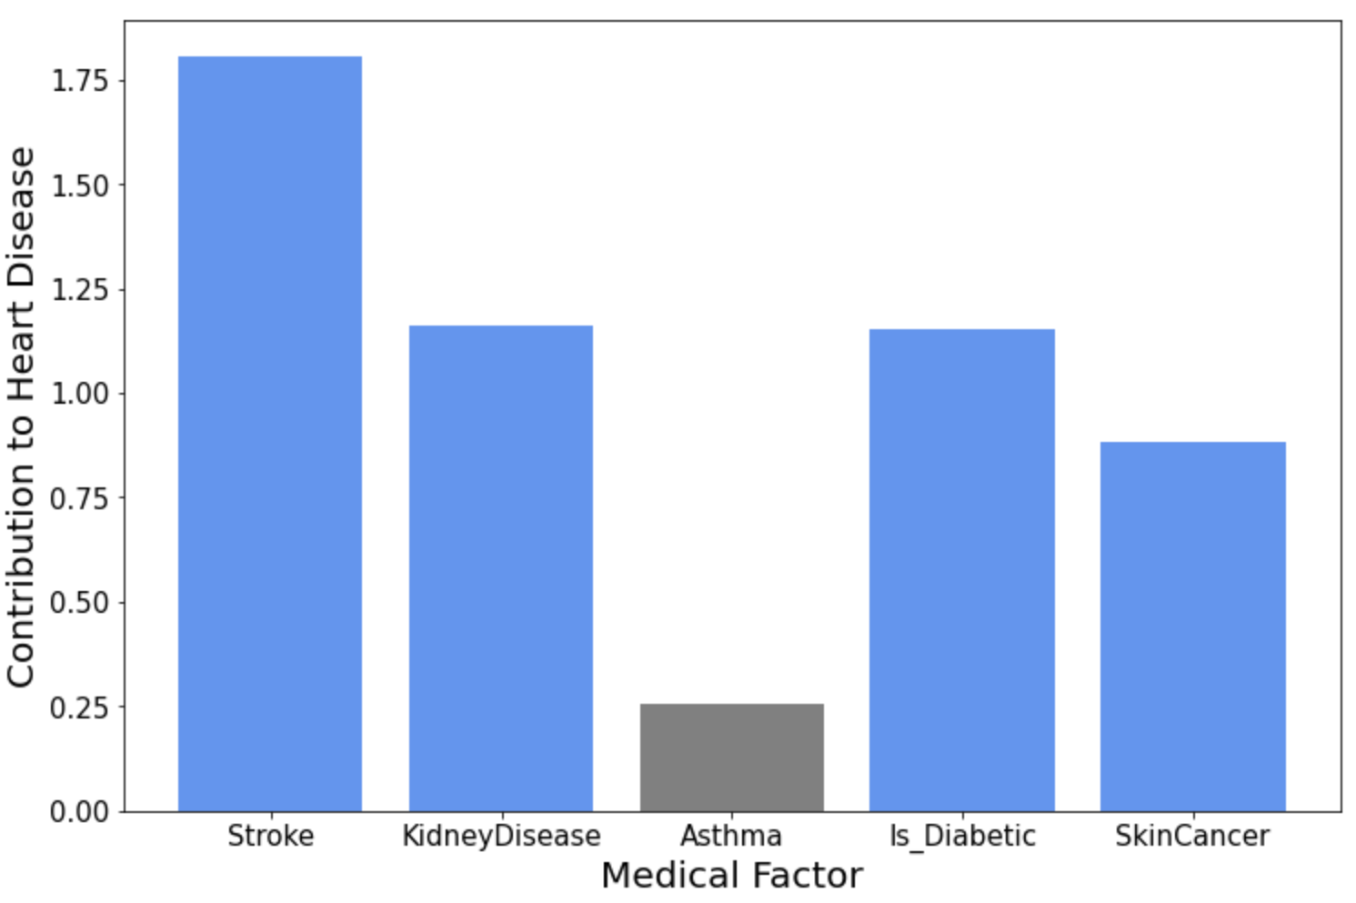
Medical Factors Contribution to Heart Disease

Slide 14
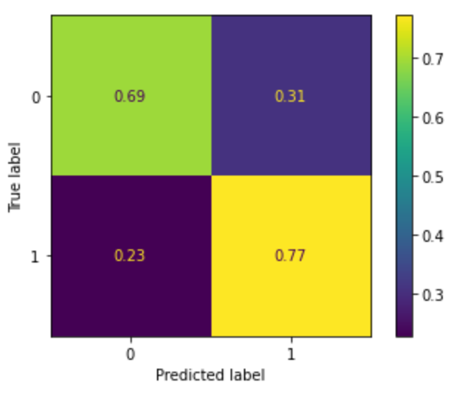
Logistic Regression (Demographic + Medical)
Factors Added: Stroke, Kidney Disease, Skin Cancer, Diabetes
Accuracy: 69%
AUROC Score: 0.73

Slide 15

Random Forest Classifier (Demographic + Medical)
Factors Added: Stroke, Kidney Disease, Skin Cancer, Diabetes
Accuracy: 68%
AUROC Score: 0.73

Slide 16
External Factors
Smoking, Alcohol, Sleep, BMI, Difficulty Walking, and Physical Activity

Slide 17
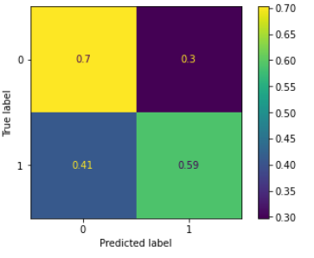
Logistic Regression External Factors
Factors used: Difficulty walking, BMI, Physical Health, Sleep, Alcohol, and Smoking.

Slide 18
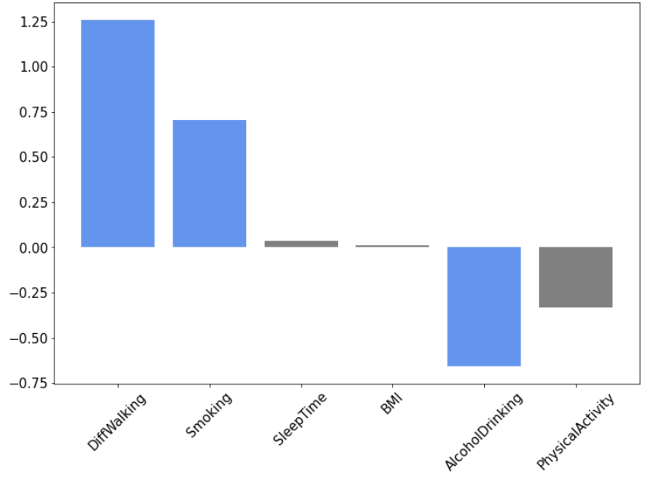
Coefficients For External Factors

Slide 19
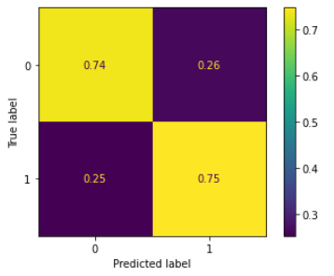
Logistic Regression (Demographic + Medical + External)
Factors added: Difficulty walking, alcohol, and smoking.
Accuracy: 74%
AUROC score: 0.74

Slide 20
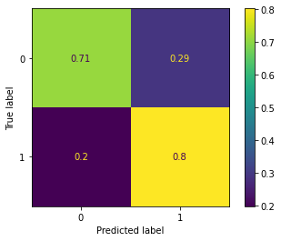
Decision Tree (Demographic + Medical + External)
Factors added: Difficulty walking, alcohol, and smoking.
Accuracy: 71%
AUROC score: 0.75

Slide 21
Conclusion
The demographic factors the gave the highest accuracy were all the races, all the ages, and sex
The medical history factors with the most impact are strokes, kidney disease, skin cancer, and diabetes
The external factors with the most impact are walking, smoking, and alcohol
Model combining all of these factors had a 71% accuracy rate and 80% TP rate at predicting whether or not someone had heart disease.

Slide 22
Thank You!

Slide 23
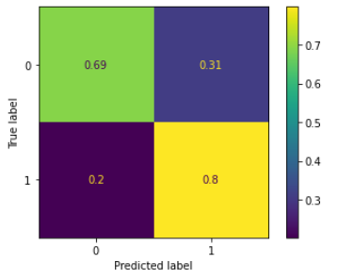
Random Forest
Accuracy: 69%

